Slide 2
Preparing for the labs
Use the VM provided on thumb drive
OR
Login to the AWS instance
Clone the Github Repository

Slide 3
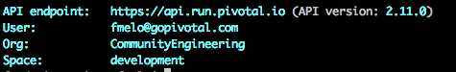
$
cf api api.run.pivotal.io
GemFire
Hawq
Spring XD
$
cf login
Email:
me@me.com
Password:
**************

Slide 4
VM Requirements
GemFire
Hawq
Spring XD

Slide 5
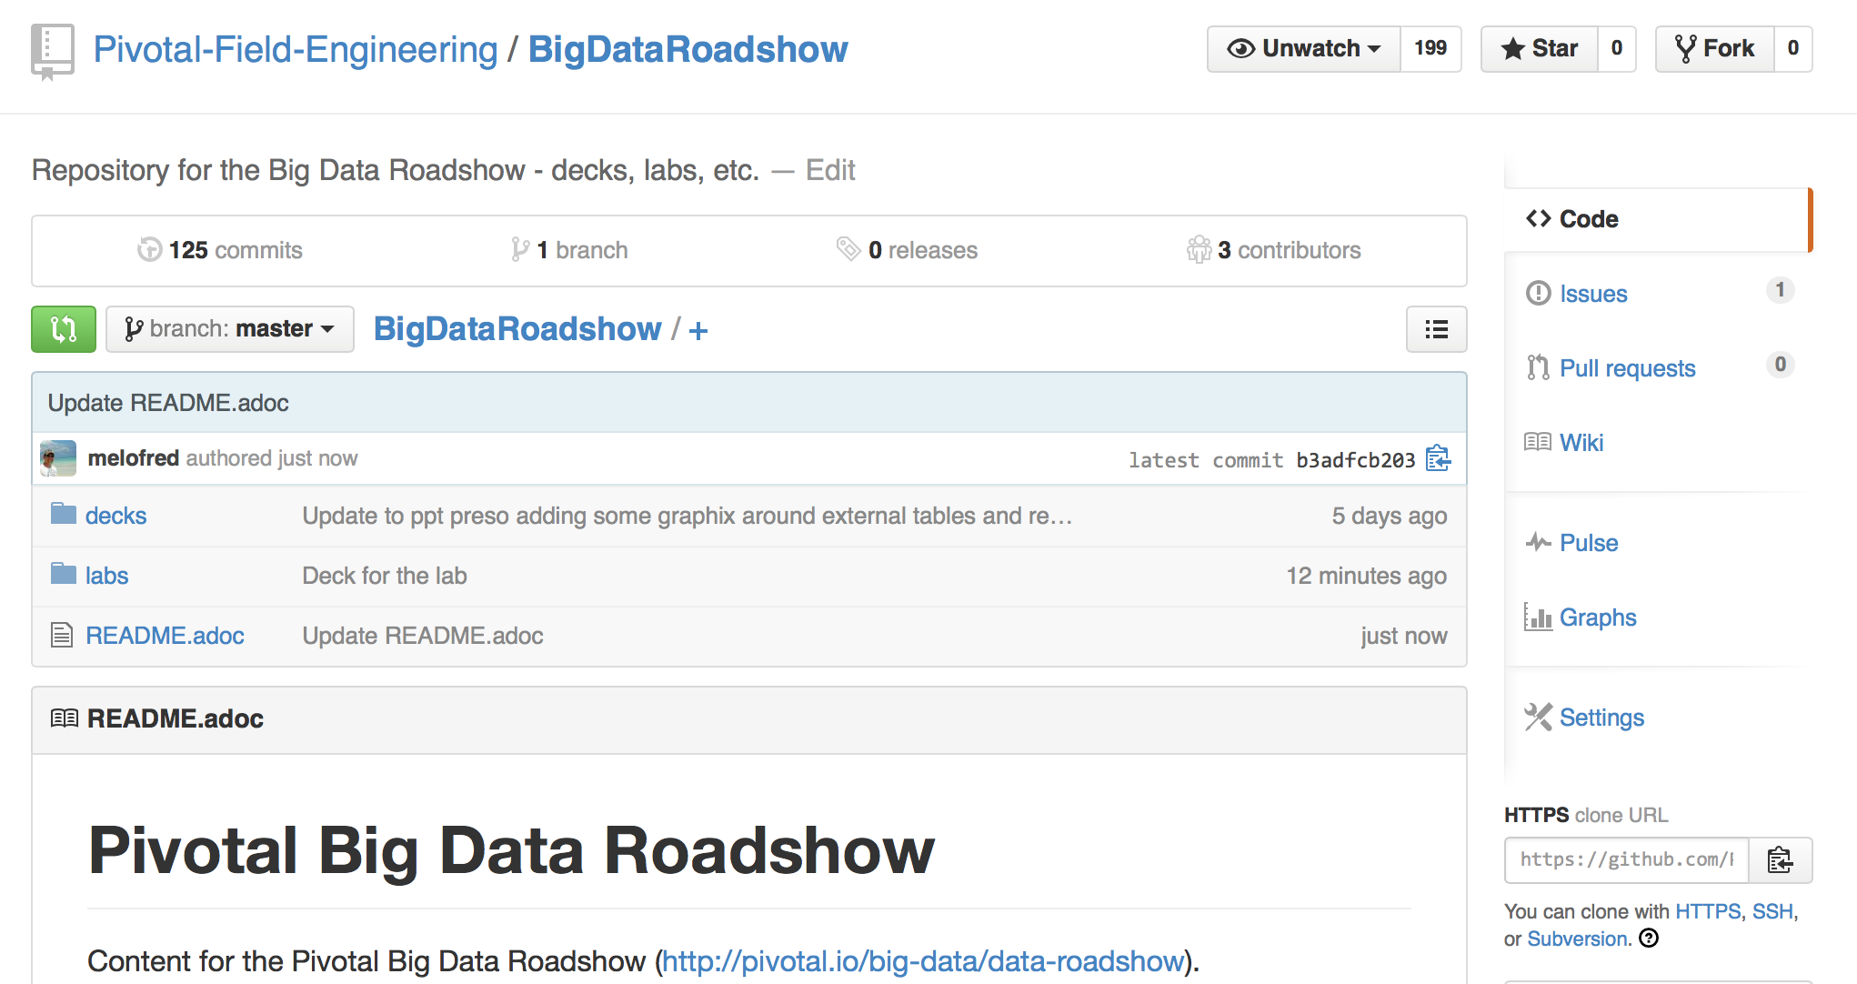
$ git clone http://tinyurl.com/pivotal-big-data-roadshow

Slide 6
Data Streaming and Spring XD
Hands-on Lab using Pivotal Big Data Suite

Slide 7









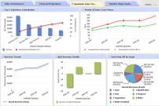
















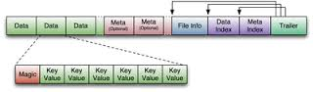
Data Streaming Reference Architecture
Data Feeds
Transactional Apps
Analytic Apps
Ingest
Filter
Enrich
Sink
SpringXD
GemFire
HAWQ
GPDB
Data Lake
HDFS

Slide 8



Spring XD – State of the Art Data Pipeline automation
Ingest / SINK
Process
Analyze
No coding required
Dozens of built-in connectors
Seamless integration with Kafka, Sqoop
Create new connectors easily using Spring
Call Spark, Reactor or RxJava
Built-in configurable filtering, splitting and transformation
Out-of-box configurable jobs for batch processing
Import and invoke PMML jobs easily
Call Python, R, Madlib and other tools
Built-in configurable counters and gauges

Slide 9


Spring XD Scale-Out and HA Architecture
XD admin
Ingest
Split
Filter
Transform
Sink
SpringXD
Stream Deployment
XD Containers
XD Containers
XD Containers
XD Containers
XD Containers
Ingest
Split
Filter
Transform
Sink
RabbitMQ

Slide 10
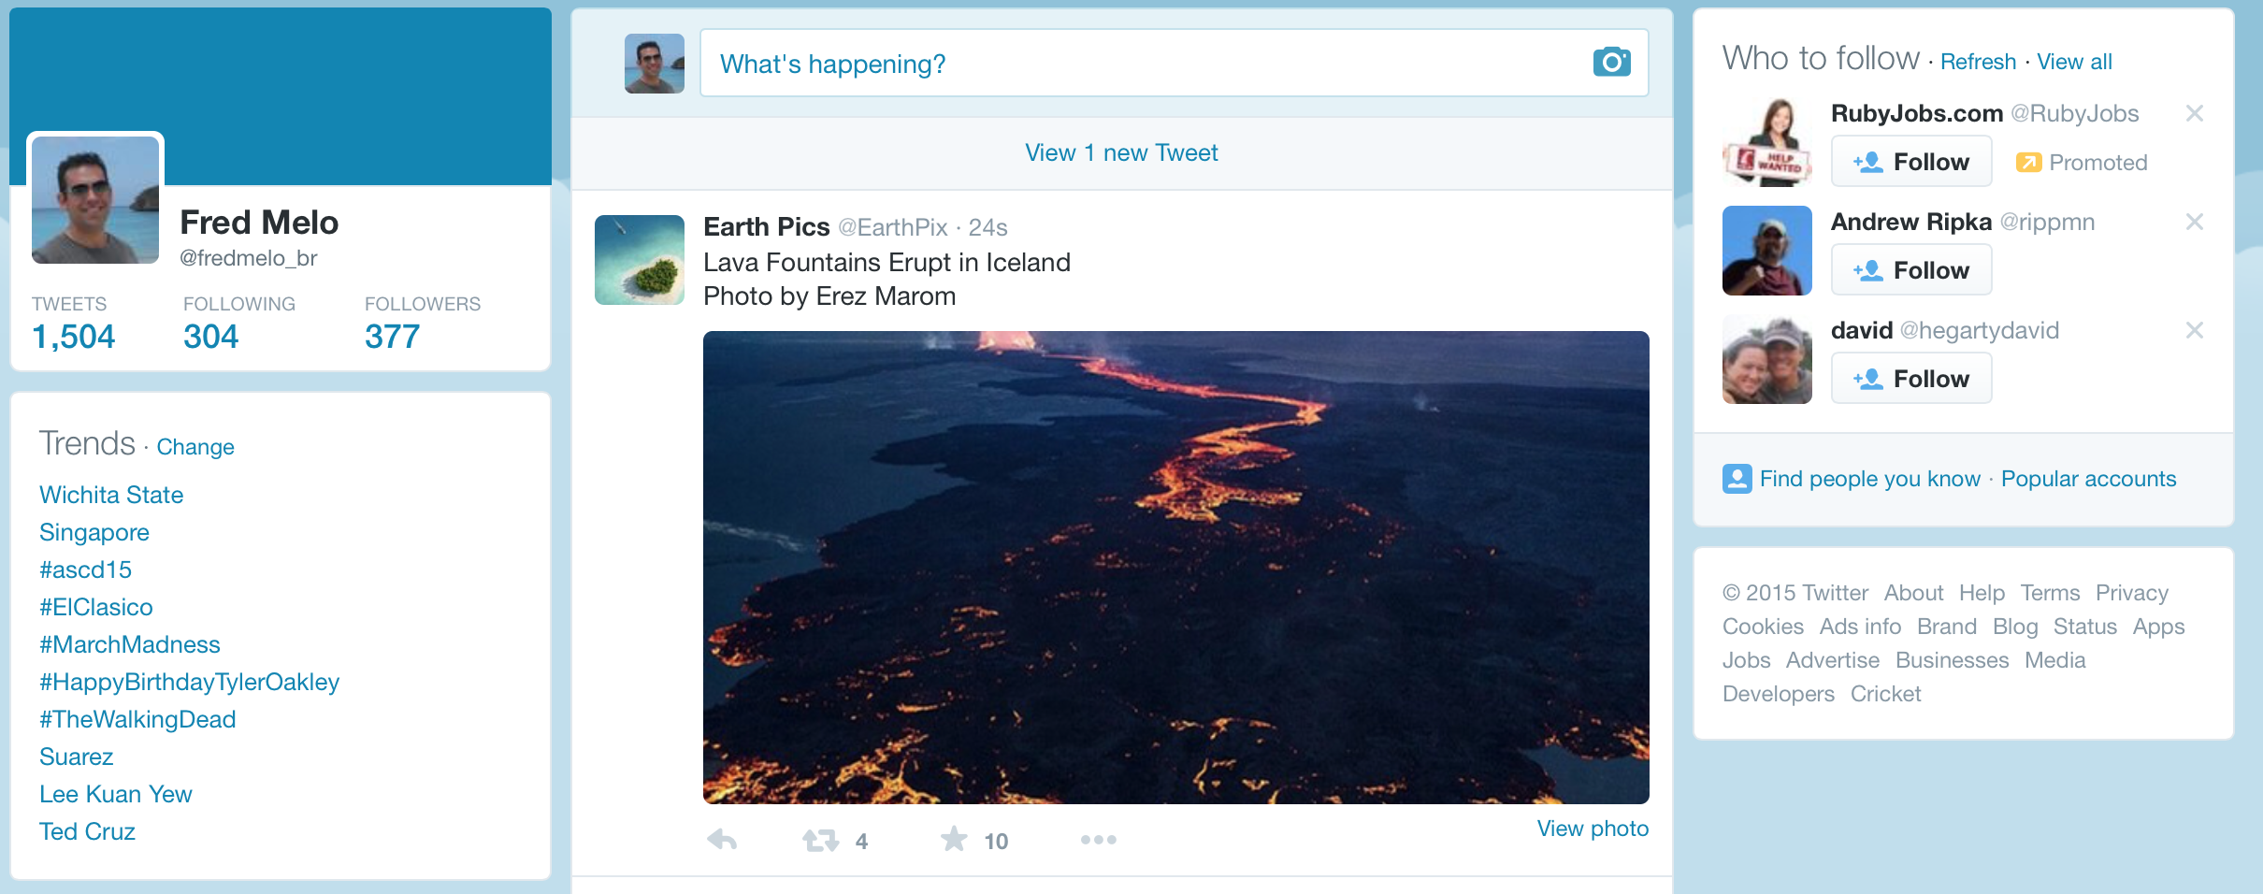
Demo: aggregating data from Twitter

Slide 11


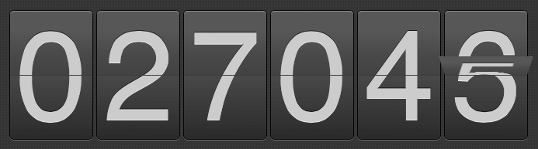
Demo: aggregating data from Twitter
Ingest
Filter
Sink
SpringXD
Tap
Log
Fast
Extensible
Open-Source
Fault-Tolerant
Horizontally Scalable
Counter
Counter aggregated by tweet language
Notes:
Search:
stream create --name tweettest --definition "twittersearch --consumerKey=eqppNxTT4pJroFG4OUHi6UZ5J --consumerSecret=1VnBvCFnEs9nszkr8Zi6uSak5h1Vn4BwFBC3n99gJ7h3l9NIG6 --query='#marchmadness' | log" --deploy
Search + Splitter:
stream create --name tweettest --definition "twittersearch --consumerKey=eqppNxTT4pJroFG4OUHi6UZ5J --consumerSecret=1VnBvCFnEs9nszkr8Zi6uSak5h1Vn4BwFBC3n99gJ7h3l9NIG6 --query='#marchmadness' | splitter --expression=#jsonPath(payload,'$.text') | log" –deploy
Search + Splitter + Filtering
stream create --name tweettest --definition "twittersearch --consumerKey=eqppNxTT4pJroFG4OUHi6UZ5J --consumerSecret=1VnBvCFnEs9nszkr8Zi6uSak5h1Vn4BwFBC3n99gJ7h3l9NIG6 --query='#marchmadness' | splitter --expression=#jsonPath(payload,'$.text') | log" –deploy
Tap for counter:
stream create tweetlang --definition "tap:stream:tweettest > field-value-counter --fieldName=lang" --deploy
See counter:
field-value-counter display --name tweetlang

Slide 12

Demo: aggregating data from Twitter
Ingest
Filter
Sink
SpringXD
Tap
Log
Fast
Extensible
Open-Source
Fault-Tolerant
Horizontally Scalable
Counter
Counter aggregated by tweet language

Slide 13
What you’ll build with no source code required
Groovy
JSON
CSV
Ingestion
Data Lake
Ingest
Split
Filter
Transform
Sink
HDFS
JSON / HTTP
SpringXD
Tap
Advanced Analytics
Fast
Extensible
Open-Source
Fault-Tolerant
Horizontally Scalable
GemFire
HAWQ
JSON / Rest
SQL
Transactional App
Analytics App

Slide 14
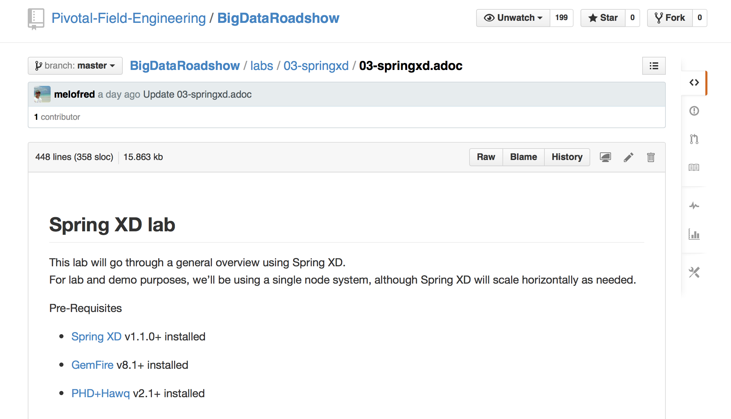

$ git clone http://tinyurl.com/pivotal-big-data-roadshow

